Slide 1


MARCH 2022
Artificial intelligence & Joint arthroplasty
The use of AI in Predictive Analytics, Operative Planning, and Implant Design in Joint Arthroplasty
ROMIL SHAH, MD
Orthopedic Surgery Resident, The University of Texas at Austin

Slide 2
AI Along the Total Joint Arthroplasty Care Continuum
Pre-Operative
Operating Room
Post-Operative
Prevention: genetic & demographic risk
Shared decision making
Operative risk calculation
Pre-operative planning
Implant design
Intra-operative guidance
Intra-operative robotics
Post-operative monitoring
Recovery and rehabilitation
Evaluating complications

Slide 3
Notes:
This is a chart of AI papers dealing with prediction in arthroplasty journals
We are on pace in 2022 to have almost a 100 papers

Slide 4
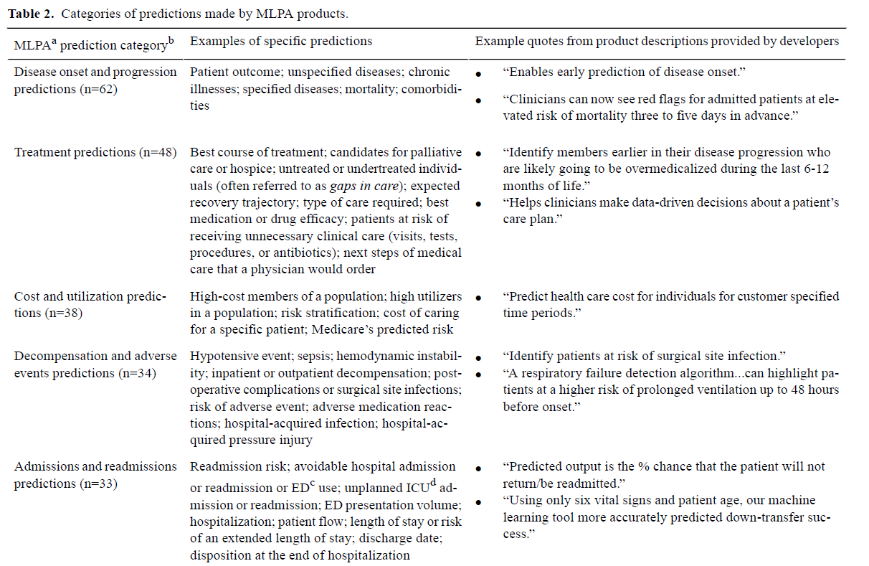
Nichol et al. A Typology of Existing Machine Learning–Based Predictive Analytic Tools Focused on Reducing Costs and Improving Quality
in Health Care: Systematic Search and Content Analysis. JMIR. 2021
Notes:
So with all that commotion, it is good to take a step back and see where predictive analytics has been actually brought to market so far.
A review of ML products from 2015-2020 which have been implemented by an identifiable US health system or provider
62 dealing with diagnosis and progression.
48 treatment products mainly targeted at identifying care gaps or undertreated/untreated patients
38 on cost, mainly administrating financial risk stratification on patient populations
34 on predicting decompensation/adverse events, and another 33 tied to readmissions – many of these focused on responses to changes in CMS reimbursement policies
Conclusion: the early products will be those that early adaptors can convince their administration to get on board for. So essentially, how can we improve ROI either by decreasing things that CMS penalizes for, how to risk stratify risky patient populations, or how to capture undiscovered income such as undertreated patients.

Slide 5
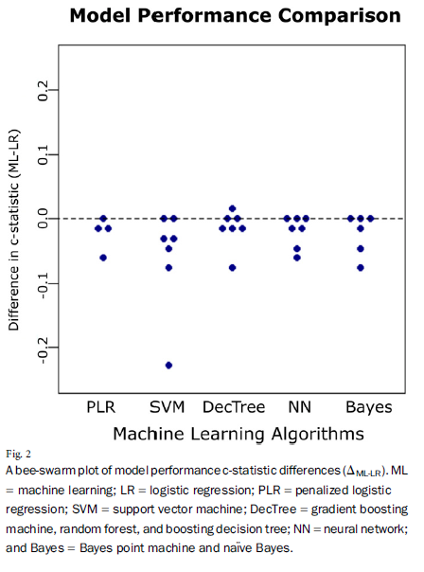
AI is not always the answer…
ML models may not be better than traditional regression for many situations
Oosterhoff et al.
Review of the predictive capability of ML vs. LR in 9 data-sets from published MSK studies
C-statistic was 0.01 higher for LR than ML, with a range from -.01 to 0.06
Oosterhoff et al. Feasibility of Machine Learning and Logistic Regression Algorithms to Predict Outcome in Orthopaedic Trauma Surgery. JBJS. 2021
Notes:
It is important to have the caveat that AI is a buzzword right now but it isn’t the answer to all our question in orthopedics
For example, we are working with genetic data right now, and the use of NNs is no better than linear regression.
A study done by Oosterhoff et al. reviewed the predictive capability of different types of ML vs. LR on 9 independent data-sets from published MSK studies. What they found was the c-statistic was actually higher in LR than ML studies in the large majority of data-sets
It is an important note for us who are excited about the tech that it may not always be the answer

Slide 6
Predictive Analytics in TJA Pre-Op
Predicting disease and progression (Guan et al., Schiratti et al.)
Predicting satisfaction and PRO improvements (Onsem et al., Jayakumar et al.)
Templating (Kunze et al., Huo et al., Polce et al.)
Predicting operative risk
Fracture Risk (Pareek et al.)
Bleeding risk → post-op CBC, TXA (Jo et al.)
Pain control issues → type of anesthesia, steroid use (Lopez et al, Karharde et al., Nair et al.)
Predicting post-operative complications
Predicting risk of loosening, infection (Devana et al, Klemt et al., Yelo et al)
TKA: predicting stiffness, instability (Bataller et al., Katakam et al.)
THA: predicting risk of dislocation, osteolysis, metal reaction (Shah et al., Langton et al.)
Notes:
So now lets shift into actual applications in TJA.
First, lets see where AI has shown to be successful pre-operatively. If AI truly offers an advantage over traditional regression, which it seems like it truly does in some cases especially when using a lot of quality data, there is a whole suite of guidance that AI has been shown to offer.
Go through list
It is likely be embedded in EMRs over the next 10-20 years to help with treatment planning, operative decision making

Slide 7
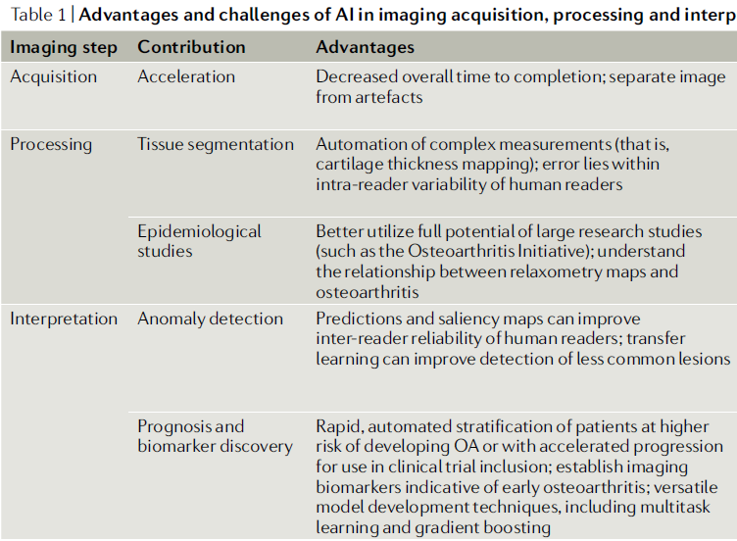
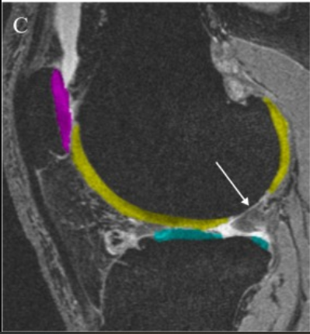
Pre-Operative Imaging
Caliva et al. Studying osteoarthritis with artificial intelligence applied to magnetic
resonance imaging. 2022. Nature Reviews
Notes:
Computer vision may redefine how we do pre-op imaging. It can help at 3 stages during the imaging lifecycle
Can allow for decreased time with acquisition of advanced imaging, allowing for less slices needed to be taken each time to recreate full imaging sets
Processing: allows for segmentation of images as seen on the right, easily identifying the different anatomic parts of an image (e.g. meniscus, cartilage, bone, etc) which allows for
(1) better, easier analysis and
(2) large scale anatomic studies can help us understand anatomy better than 50 or 100 image studies that are manually labeled by researchers. Allow us to better understand bony anatomy and wear patterns helping create better and in some scenarios when financially viable, patient specific implants.

Slide 8
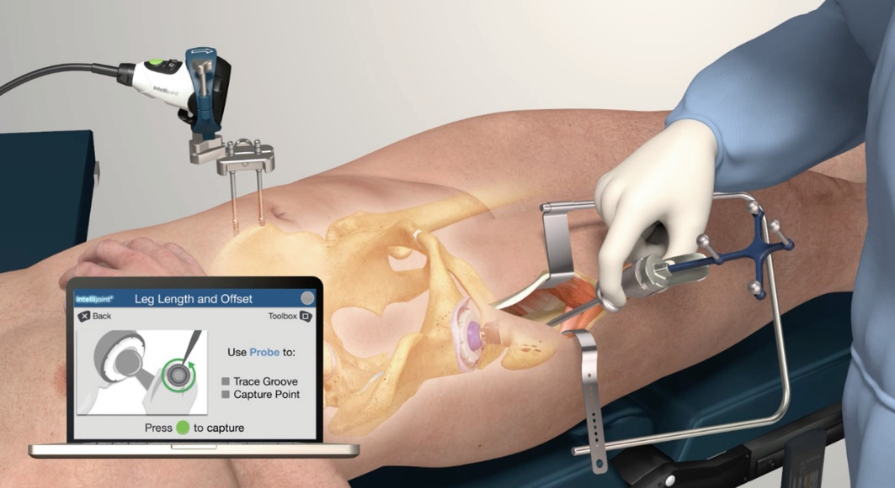
Intra-Op Guidance
THA (Rouzrokh et al.)
Version/Inclination/Offset
Fracture
Stability
TKA (Verstraete et al.)
Patellar tracking
Rotation of implants
Balancing
Notes:
AI can help automate aspects of an operative case to build accuracy. For example in THA…. And in TKA …
The biggest barrier to this right now is building a dabatabe of good operative images to train to
The tools that will succeed will require little surgical time and effort – if adds operative time, not worth it. It also must integrate with other solutions (navigation, robot, room lights, etc)

Slide 9
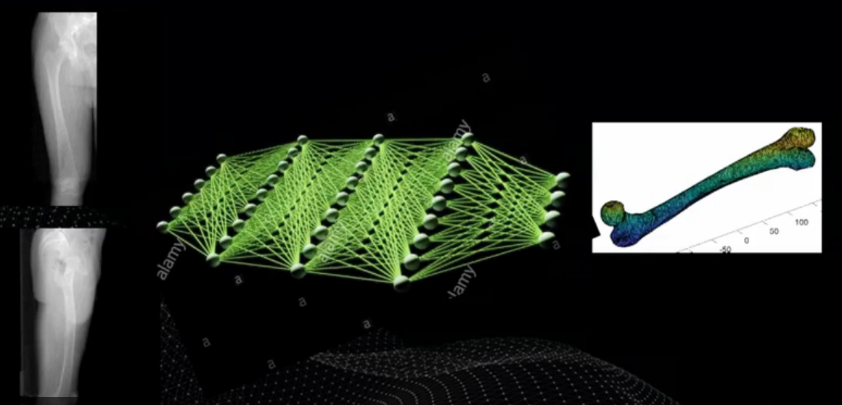

Intra-Op Robotics
2D to 3D conversion of images
Replacing the need for a pre-op CT scan
Quicker Registration
Less Invasive Array Placement
Notes:
Another promising area is the replacement of need for advanced imaging.
Several companies are working on tools that convert 2D to 3D images, essentially an XR to a CT scan.
If able to use an intra-op XR for navigation or robotic purposes, you could do the following:

Slide 10

NLP to collect billable codes
Operative data performance | Accuracy | Sensitivity | Specificity
General
Approach | 99% | 99% | 99%
Anesthesia type | 100% | 100% | 100%
Implants
Brand | 98% | 97% | 97%
Type | 91% | 92% | 90%
Size | 93% | 99% | 90%
THA
Repair of external rotators | 95% | 93% | 96%
Stability of implants | 99% | 98% | 99%
ROM tested | 99% | 99% | 99%
TKA
Angle of tibial slope | 97% | 98% | 92%
Angle of tibial cuts | 97% | 98% | 92%
Angle of femoral cuts | 95% | 95% | 93%
Level of constraint used | 99% | 99% | 98%
Metal augmentation | 98% | 99% | 97%
Patella malalignment | 99% | 99% | 98%
Other
Presence of drain | 100% | 100% | 100%
Suture type | 93% | 92% | 98%
Suture size | 92% | 92$ | 97%
Use of TXA | 100% | 100% | 100%
NLP algorithms built to abstract coded data (17 variables) from operative notes
Collected data with high accuracy, sensitivity, and specificity. Better at structured data
Billing and Registry implications
Notes:
NLP is also a tool that surgeons may see soon.
One of our studies used NLP to automatically collect structured data points from an operative report. It was able to collect 17 variables dealing with things like implant type to angle of tibial cuts with high accuracy.
This can help automate billing codes or make sure all billable codes are being accounted for in young surgeons.

Slide 11
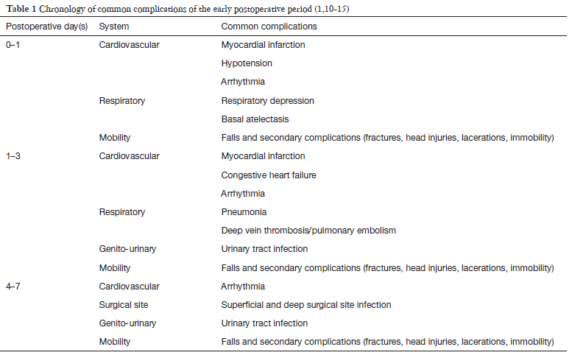
Post-operative monitoring
Current Sensors
O2 Saturation
ECG
Optical Heart Sensor (HR)
Accelerometer (Steps, Speed, Calories)
Gyroscope (falls)
GPS/Altimeter
Future Sensors
Blood Glucose Monitor
Blood Pressure Monitor
Body Temperature Monitor
Amin et al. Wearable devices for patient monitoring in the early postoperative period: a literature review. 2021. mHealth
Notes:
Post-operatively, the amount of data that can now be passively collected by wearables has skyrocketed.
This is the current capacity, and in the next 10 years we will see these future capacities.
Many of the post-operative complications have been shown to be predictable by an analysis of the data continuously collected by current/future sensors. This may allow for early patient discharges with continuous monitoring situations, and detection of complications or decline for early interventions

Slide 12
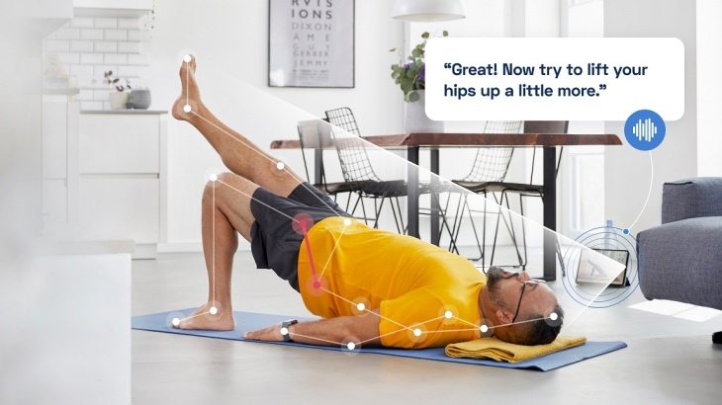
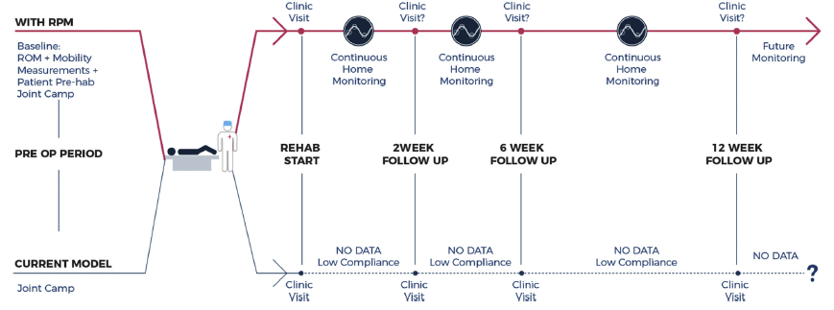
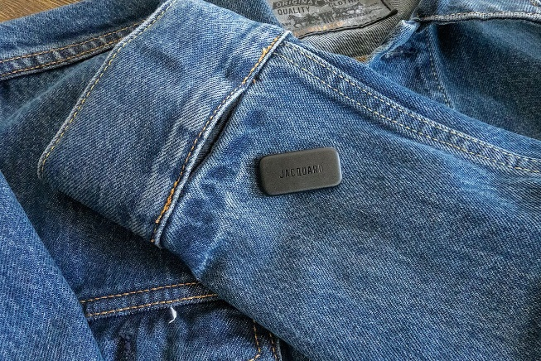
Post-Operative Recovery
Ramkumar et al. Remote Patient Monitoring Using Mobile Health for Total Knee Arthroplasty: Validation of a Wearable and Machine Learning eBased Surveillance Platform. 2019. Journal of Arthroplasty
Notes:
And then there is post op rehab.
2 interesting innovations in this space.
A couple of companies use video analysis of a patient to create custom PT for each patient and can critique their form in real time. So like this picture from Kaia health in the top left, something would critique a ptients form and track a patient’s progress via a remote monitor
And then the other innovation is powerful sensors which can analyze a patient’s kinematics. Google has been working on devices that a patient can wear for a series of exercises and it can measure a patient’s knee angular velocity and ground reaction forces in real time without an expensive gait lab
This will allow for a more continuous patient monitoring of patients, allowing for a better lens into how patients are doing after surgery

Slide 13
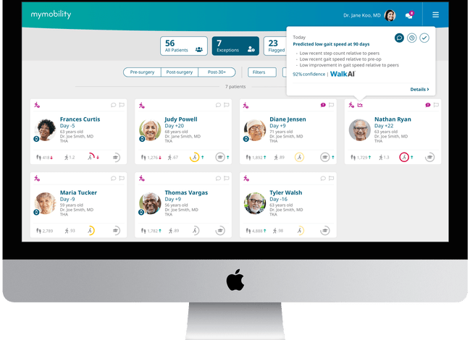
Stewart, Chris. Zimmer Biomet Debuts WalkAI™ Artificial Intelligence Model to Predict Post-Operative Recovery Progress. Ortho Spine News. 2022
Notes:
From a providers perspective, this will allow providers to see the continuous progress of patients and identify poor performers in a dashboard like the one here
This will allow for earlier intervention in at-risk patients

Slide 14
AI Along the Total Joint Arthroplasty Care Continuum
Pre-Operative
Operating Room
Post-Operative
Prevention: genetic & demographic risk
Shared decision making
Operative risk calculation
Pre-operative planning
Implant design
Intra-operative guidance
Intra-operative robotics
Post-operative monitoring
Recovery and rehabilitation
Evaluating complications

Slide 15

Thank You

