Slide 1


MARCH 2022
challenges and opportunities in the adoption of ai in orthopedics
What are the barriers to the widespread adoption of AI and to starting AI projects at your own institution
ROMIL SHAH, MD
Orthopedic Surgery Resident, The University of Texas at Austin

Slide 2
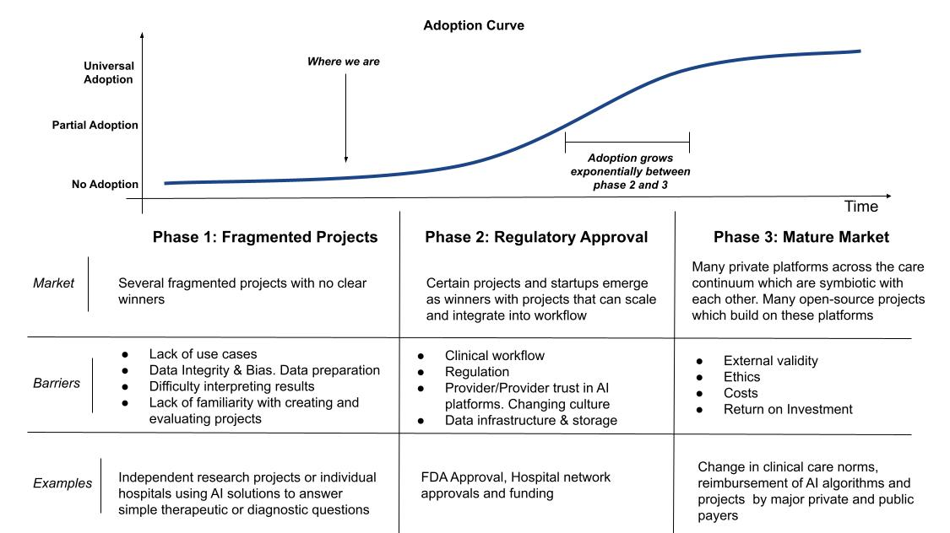
Notes:
I wanted to talk about this in the framework of an adoption curve. Essentially it is a logarithmic curve which demonstrates adoption and the things that are needed before exponential growth in adoption.
We will focus on phase 1 and phase 2 in this talk as this is what we will see in terms of barriers in the next 10 years

Slide 3
Notes:
Phase 1: essentially has several fragmented projects which come up around this time with no clear winners or defining projects yet.
The barriers that we see here are a lack of use cases, data integrity & bias, and a difficulty with creating, evaluating, and interpreting results

Slide 4
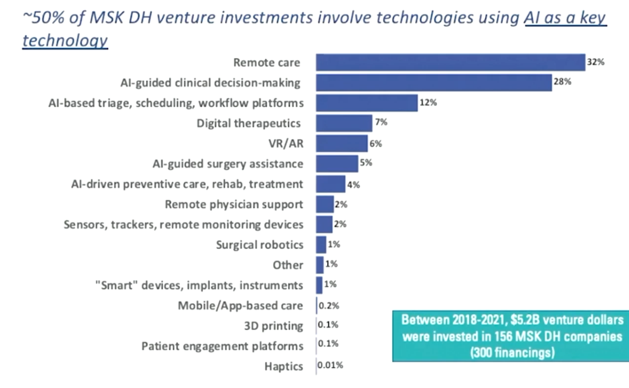
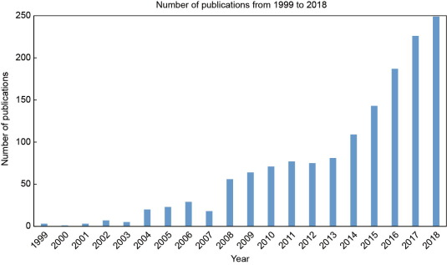
No Shortage of Use Cases
Amount of AI Articles Published in
Healthcare Journals
Rong et al. Artificial Intelligence in Healthcare: Review and Prediction Case Studies. 2020. Engineering
Lynch, Nancy. Investment Trends in Musculoskeletal Digital Technologies. DOCSF Venture.
Notes:
I would say that coming up with use cases is no longer an issue in AI.
The chart on the left is the amount of AI articles published in healthcare journals per year, it has skyrocketed in recent years.
The chart on the right is a chart of where VC money has gone in the past 3 years in terms of MSK digital health, 50% of which has gone into AI related tech showing that many products are soon to be on the market

Slide 5
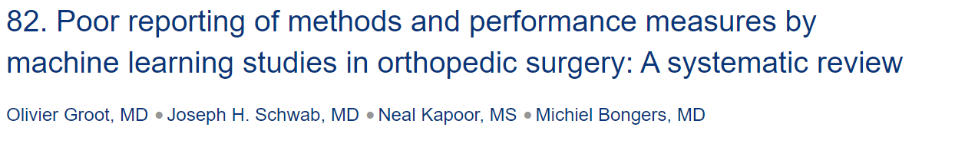
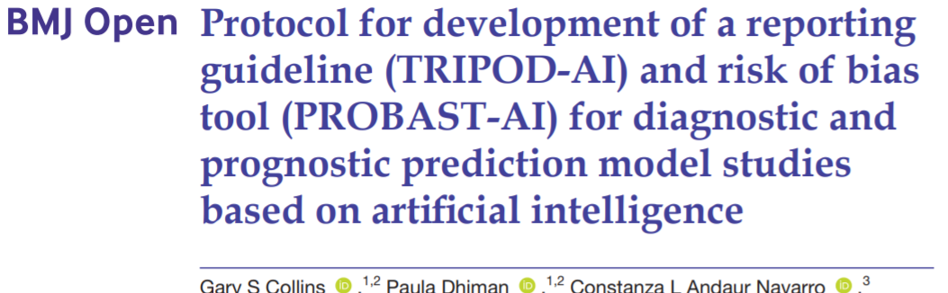

Effective Reporting & Interpreting ML Studies
A systematic review of risk of bias in ML studies published in orthopedic literature
Risk of bias was high or unclear in 56% of papers due to incomplete reporting of performance measures, inadequate handling of missing data, and use of small datasets with inadequate outcome numbers
Notes:
One thing that is a big issue is the reporting and interpretability of AI projects
A study last year looking at ML studies in orthopedics and the bias that existed found:
From studies like this, there has been an emphasis on 2 things:
focusing on creating a checklist or guidelines for the effective reporting of AI studies (like the TRIPOD-AI tool and
trying to educate the public on how to read and analyze machine learning studies (in the same way they do other studies)
Full open source code for all AI studies

Slide 6
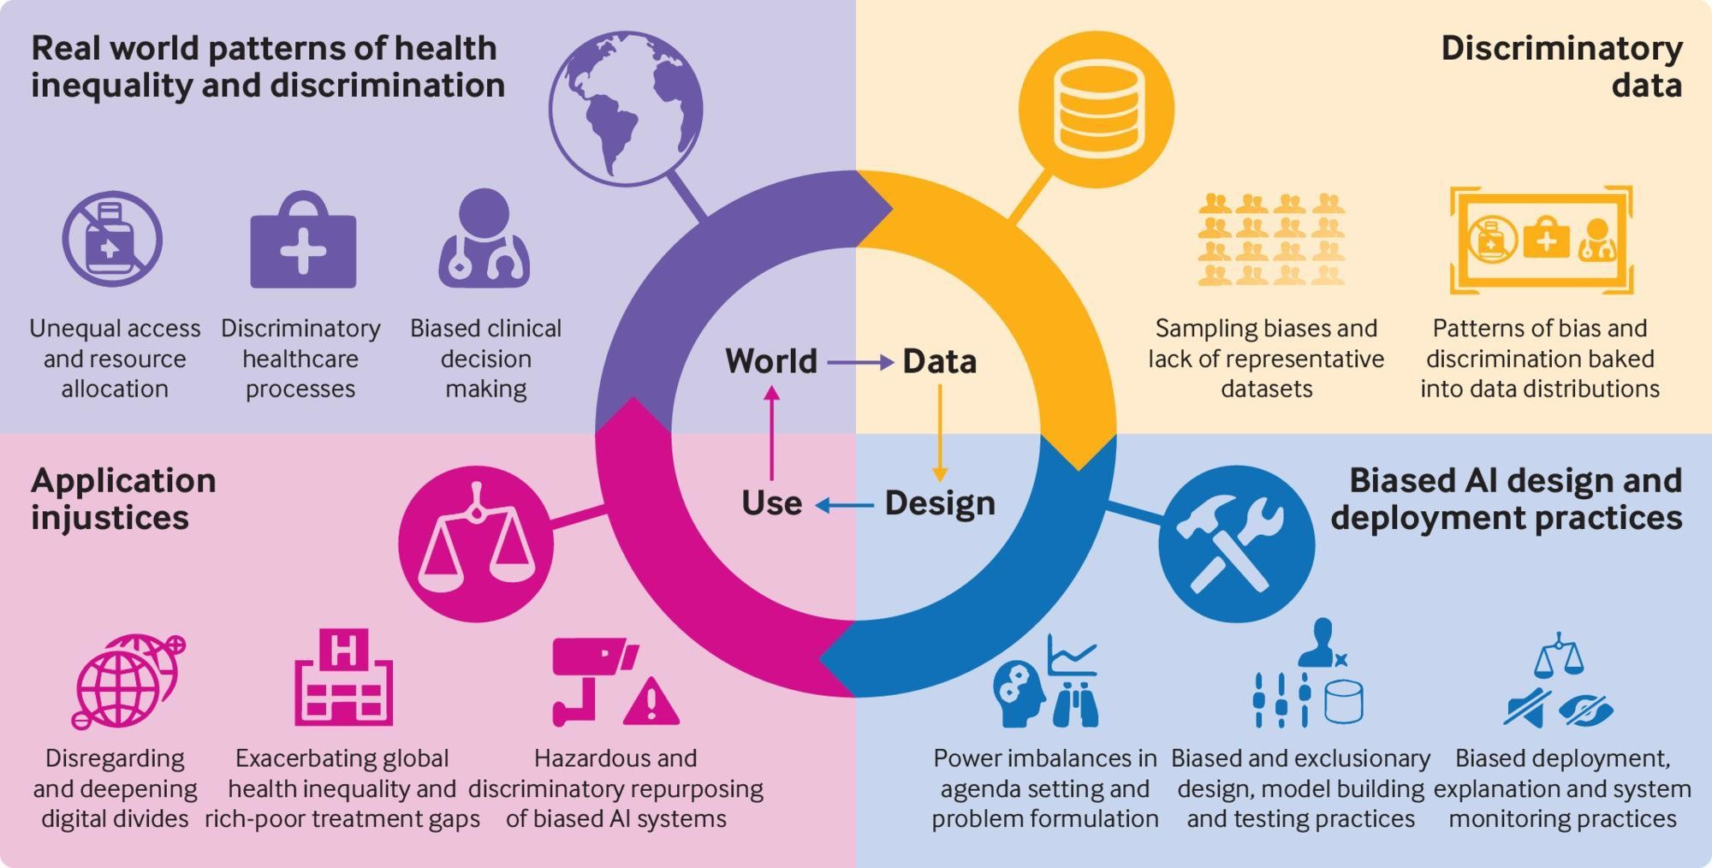
Bias
Omowole et al. Research shows AI is often biased. Here's how to make algorithms work for all of us. 2021. World Economic Forum
Gervasi et al. The potential for obias in machine learning and opportunities ofr health insurers to address it. 2022. Health Affairs
Notes:
Potential bias is also a barrier that has been in the news recently. A risk-stratification model developed by an insurance provider resulted in significant racial bias against black patients when health costs were used as a proxy measure of health needs.
As we move forward, we need to be cognizant of this possible bias. For example,
The training data sample may have data that represent real world patterns of health inequality such as unequal access and provider bias. For example, a certain population may have less frequent compliance with follow-up but that may be due to transportation or cost.
The design of projects and the funding behind them may also be unequal and exclusionary of certain groups
And the use of these projects may improve healthcare for only certain populations if parts of the country can’t have access to them making inequalities worse

Slide 7
Notes:
We are figuring out many of the aforementioned issues right now and are nearing the end of this phase.
As we move forward, there are several hurdles that we need to address before the large scale adoption of AI. These include figuring how to integrate these projects into clinical workflow, regulatory approval, and changing perceptions of AI

Slide 8

Principles of Integrating Projects into Clinical Workflow After Development of Project
Right information, to the right person, right format, through the right channel, at the right time in the workflow
Creating a team with buy-in from organizational stakeholders
Piloting a solution is critical for finalizing workflows
Trying to maintain transparency throughout, avoiding “stealth science”
Notes:
Integrating AI models into clinical workflow will be difficult but will require similar principles to any QI project.
Those are as follows.
Essentially, practice principles that any PDSA QI project would follow are important for clinical integration

Slide 9
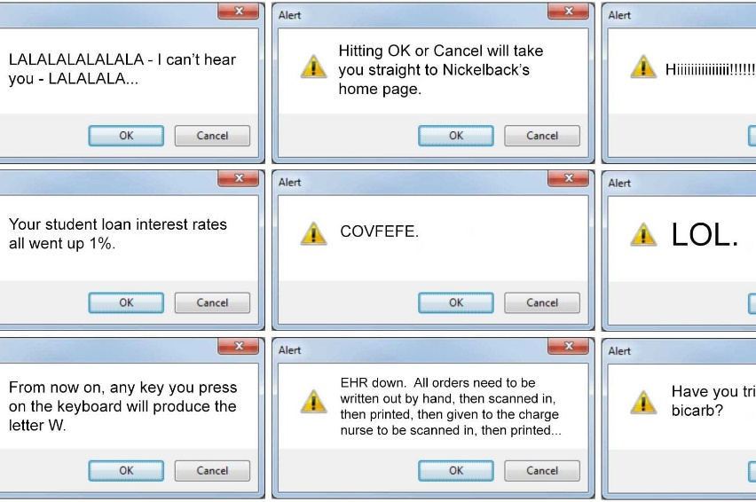
Clinical Workflow Principles
Integrating into clinical workflow requires:
  Clinical integration: support decision making with minimal provider interruption
  Technical integration: accuracy and reliability
  Organizational integration: increase revenue, decrease costs, improve brand equity
Scaling is not cheap: >200K to integrate into EMR
Notes:
When trying to integrate AI projects, you must think of clinical, technical, and organizational integration:
Clinical integration: you need to help a provider with minimal increase in provider time. An example of poor integration is popups in your EMR
Technical Integration: can the model be accurate and reliable throughout a day
Organizational Integration: can this model save costs, can using it increase reimbursement, can it improve brand equity?
Diffusing and Scaling is not cheap:
integrating with EMRs is not cheap, requires >200K in some situations in the past few years.
And is not scalable yet because EMRs don’t talk to one another.
That is why today, so many of these AI models embedded into website are not used because they require manual data entry and they are not well integrated.

Slide 10
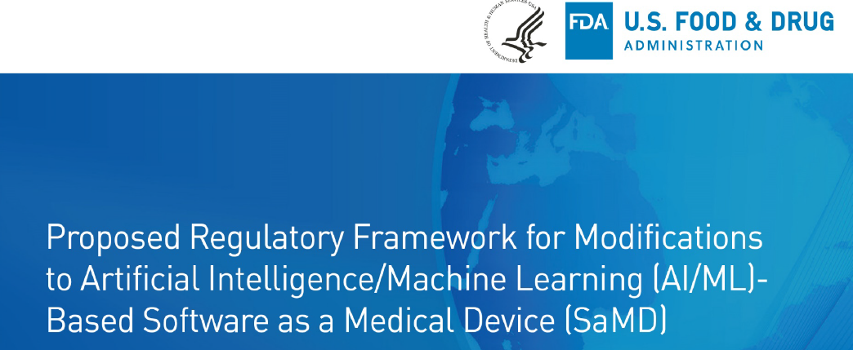
FDA Regulation of AI Projects
“The highly iterative, autonomous, and adaptive nature of these [AI/ML] tools requires a new, total product lifecycle (TPLC) regulatory approach”
Notes:
FDA approval is the next big step
The big difference with AI projects is that AI projects constantly update, and therefore require a different set of regulations before updates are administered

Slide 11
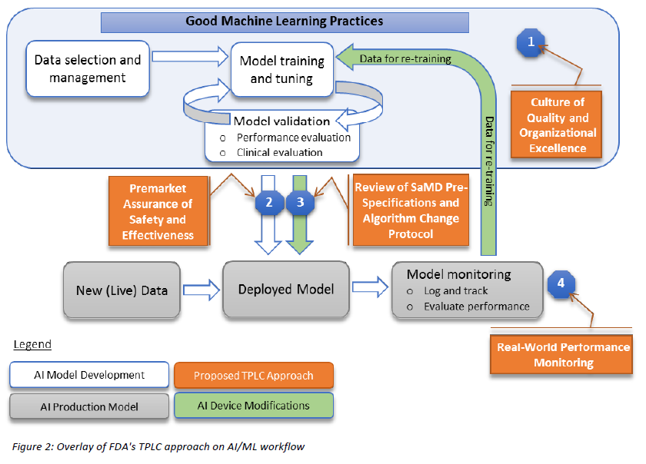
Developing an effective Algorithm Change Protocol (ACP)
Need to foresee expected modifications in these areas
  Modifications related to performance of the model: change in an algorithm’s architecture
  Modifications related to inputs: new source of data input, or new variables to be included in the model
  Modifications related to the intended use: new population or new physiology
Step-by-step delineation of expected changes is needed
Notes:
Essentially, this means that each product or project must account for expected changes with an ACP.
Understanding what types of modifications are possible:
Modifications to performance which includes changing the algorithm structure itself
Modifications to the inputs itself, either from a new source or using new input variable types
Modifications to the algorithms intended use, either to a new population or for a new physiology
Before coming the market, developing a comprehensive ACP will prevent the need for new FDA applications each type a ML model updates itself

Slide 12
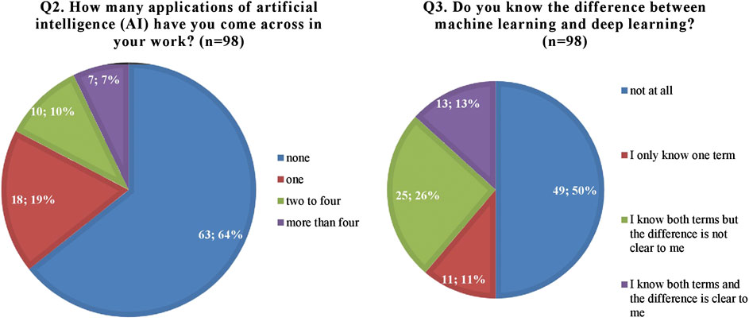
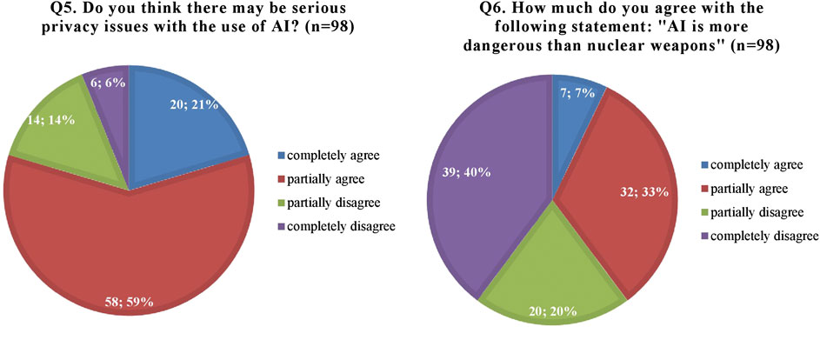
Provider Perceptions of AI
Survey based study of 98 healthcare professionals (34 doctors, 24 nurses)
Castagno et al. Perceptions of Artificial Intelligence Among Healthcare Staff:
A Qualitative Survey Study. Front. AI. 2020
Notes:
Perceptions of AI are somewhat skewed currently.
This is a study on 98 healthcare professionals (58 of which were doctors or nurses). 64% of providers have never come across AI, almost 90% don’t understand the difference between types of ML, 80% think there are significant privacy issues with AI, and 40% of providers agree with the statement “AI is more dangerous than nuclear weapons.”
Clearly, education about what AI is and how it can be helpful is needed for providers

Slide 13
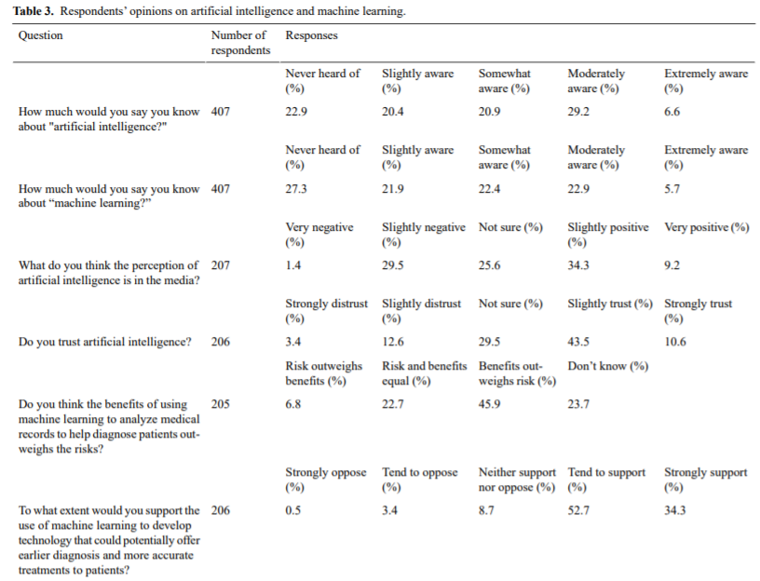
Patient Perceptions of AI
Survey of 408 patients at a teaching hospital in the UK
Aggrawal et al. Patient Perceptions on Data Sharing and Applying Artificial Intelligence to Health Care Data: Cross-sectional Survey. JMIR. 2021
Notes:
But it is also needed for patients
This is a cross-sectional survey of 408 patients at a teaching hospital in the UK answering questions about AI
45% of patients do not trust AI, 55% of patients are unsure if the use of AI in predictive analytics have benefits which outweigh risks
Patient education is needed to help patients understand what AI is

Slide 14
Notes:
After these barriers are completed, we come to a mature market where private platforms across the care continuum are symbiotic with each other, and many open source platforms that providers can iterate on
Like any technology, this will have barriers as well like ROI, ethics, and external validity. Early in this time period there will be an emphasis on trying to get reimbursement for AI platforms so that they are financially viable

Slide 15
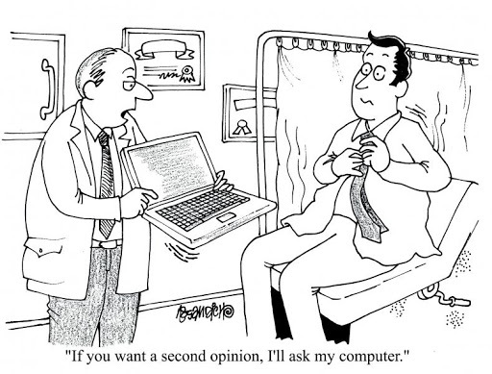
Steps to Get Involved/Ready
Become familiar with AI methodology to evaluate the validity and clinical utility of projects
Engaging stakeholders early to understand their concerns and drivers
Understand the perception of AI in your institution and begin educating the workforce on how AI can help
Engage with EMRs about how to integrate algorithms into your workflow at a reasonable cost
Notes:
I wanted to end the symposium with some steps how to get involved with the AI onslaught that is coming.

Slide 16
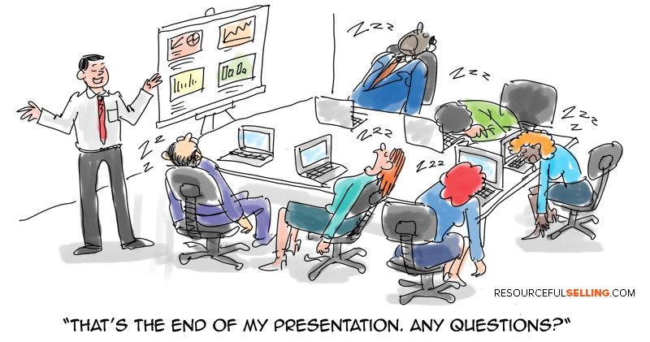
Thank You!
Notes:
Thank you for being here on the last session on Friday!

